Slide 1
BALANCED TREES

Slide 2
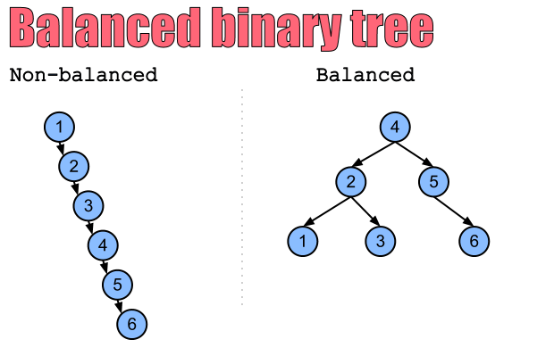
BALANCED TREES

Slide 3
AVL TREES

Slide 4
WHAT DOES AVL STAND FOR?
Adelson-Velskii and Landis (named after the inventors)

Slide 5
WHAT IS AN AVL TREE?
An AVL tree is a binary search tree (BST)
It is a balanced tree. This means that the height of the left sub-tree and height of the right sub-tree differ by at most 1

Slide 6
HOW TO TELL IF IT’S BALANCED
To calculate the balance of a tree:
Balance factor = height of left subtree – height of right subtree
For a tree to be considered balanced, the balance factor must be -1, 0, or 1.

Slide 7
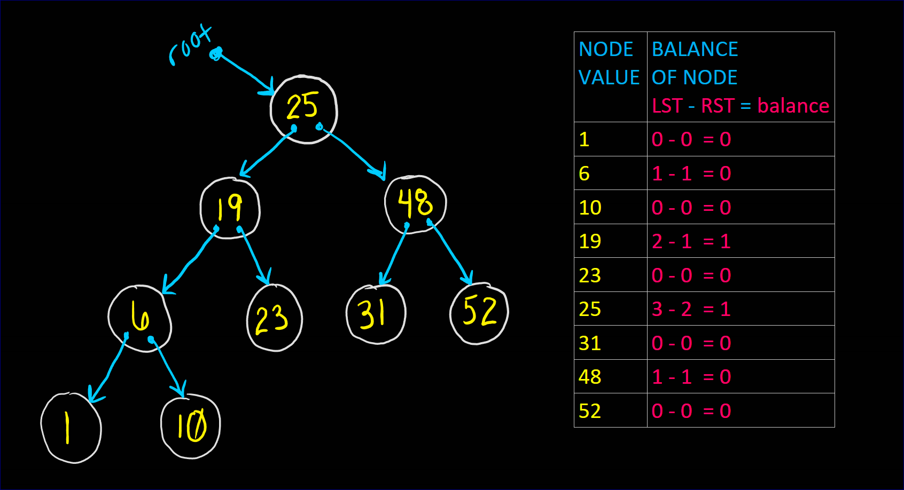
THIS IS A BALANCED TREE

Slide 8
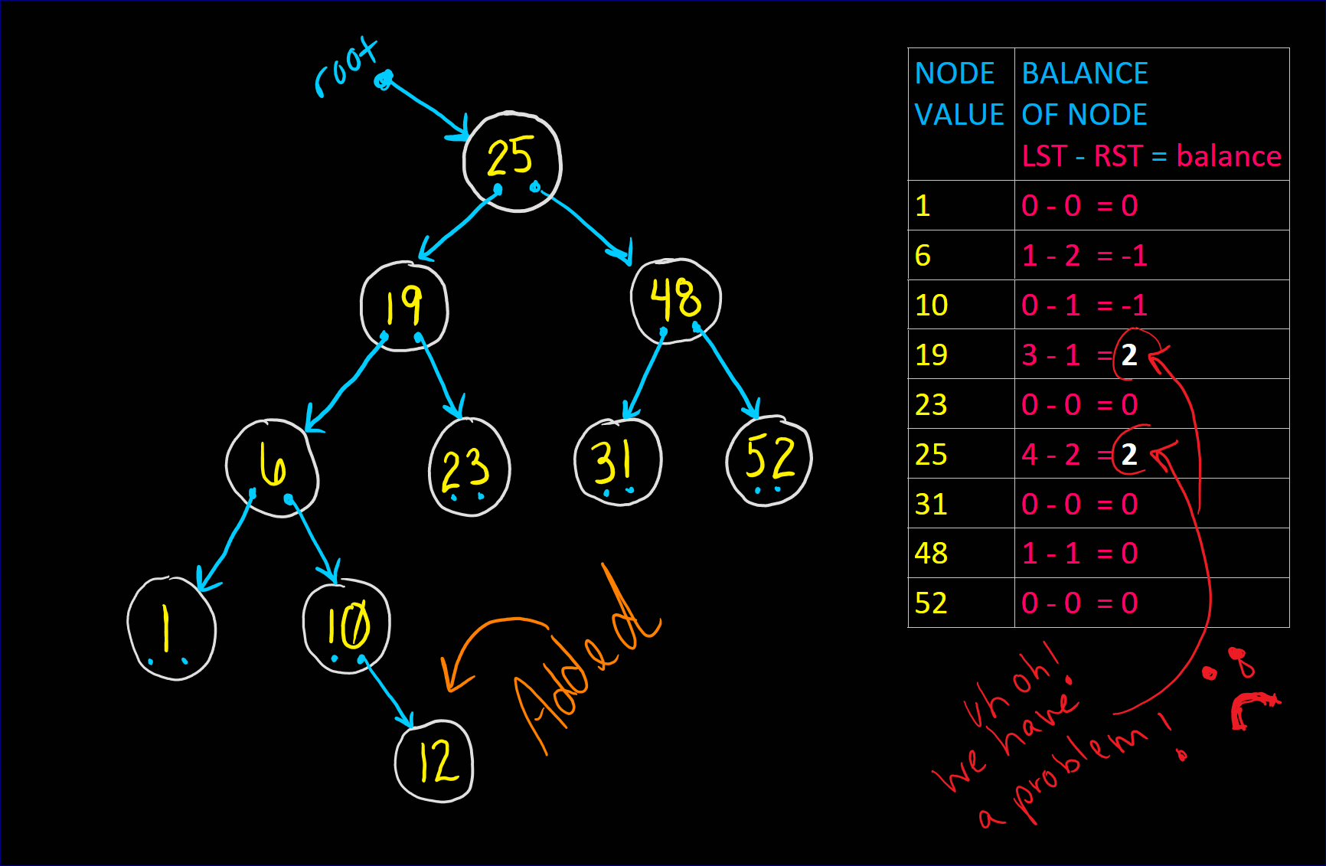
WHAT HAPPENS IF I ADD A NODE?

Slide 9
MAKING A TREE UNBALANCED
FOUR ways to cause a tree to be UNBALANCED
insert into the left sub-tree of the left child
insert into the right sub-tree of the right child
insert into the left sub-tree of the right child
insert into the right sub-tree of the left child

Slide 10
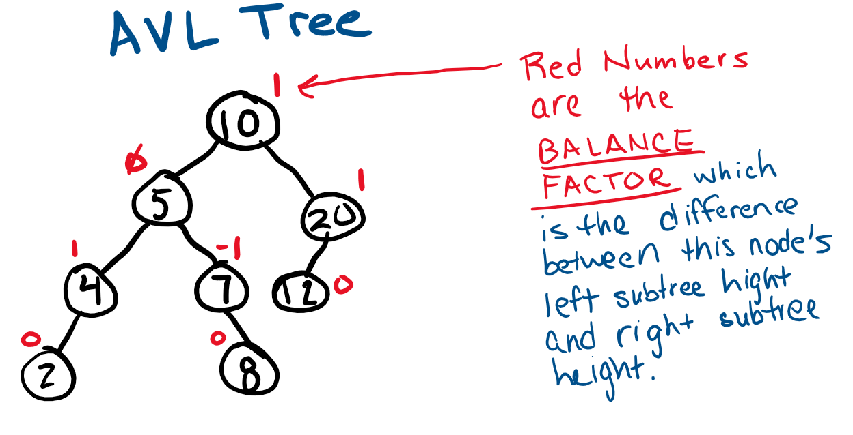
AVL tree (balanced BST)
An AVL Tree is a Binary Search Tree (BST) in which the Balance Factor of every node is either 0, 1, or -1.

Slide 11
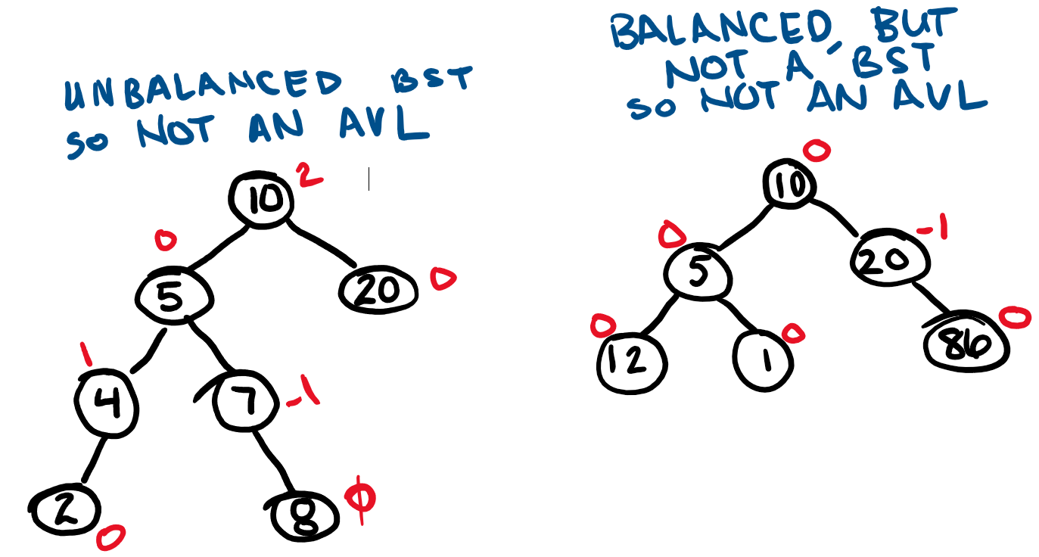
AVL or not?

Slide 12
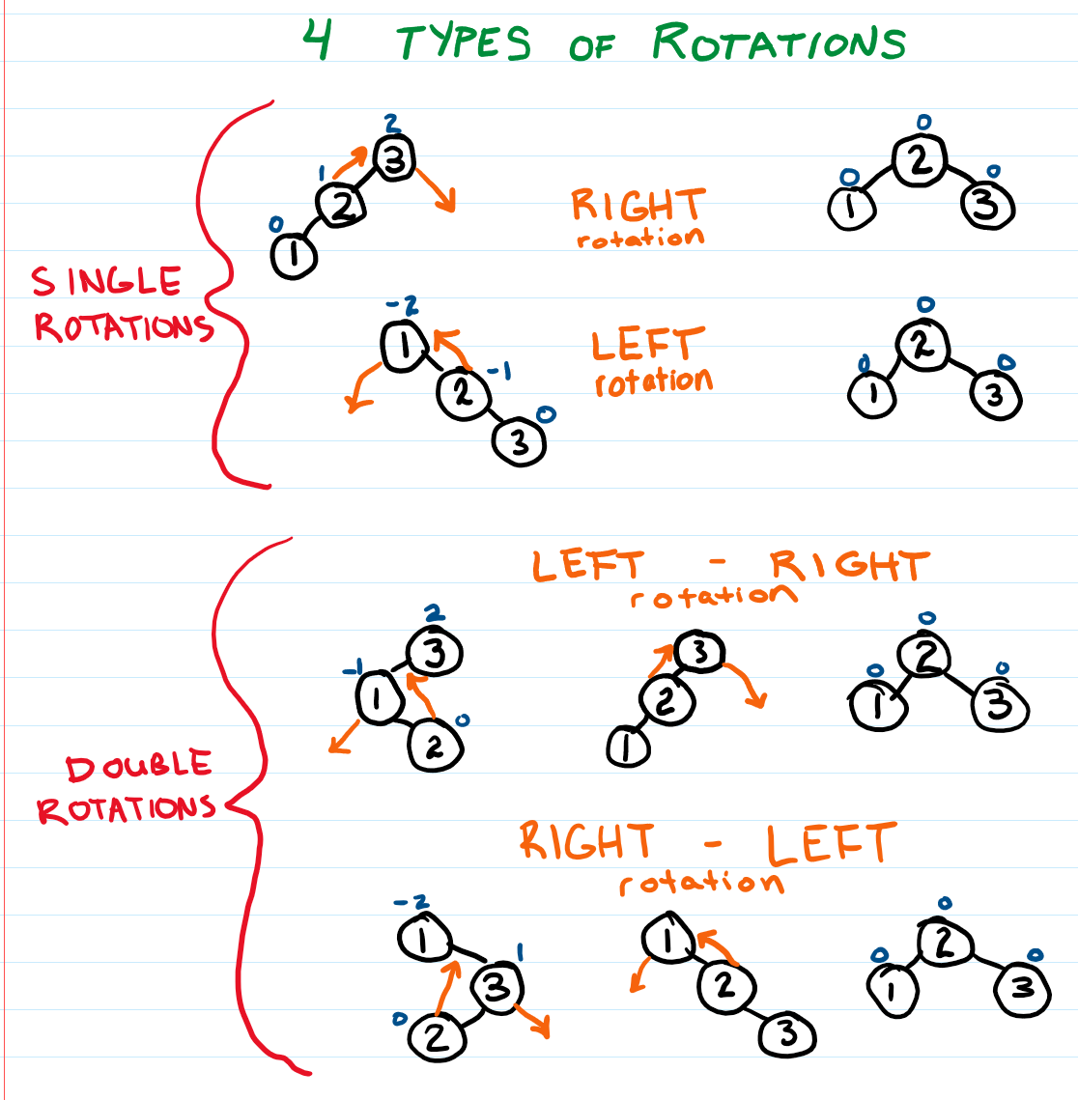
Keep an AVL Tree balanced by doing ROTATIONS when a node has a balance factor other than 0, 1, or -1.
There are four types of rotations – two are single rotations and two are double rotations.

Slide 13
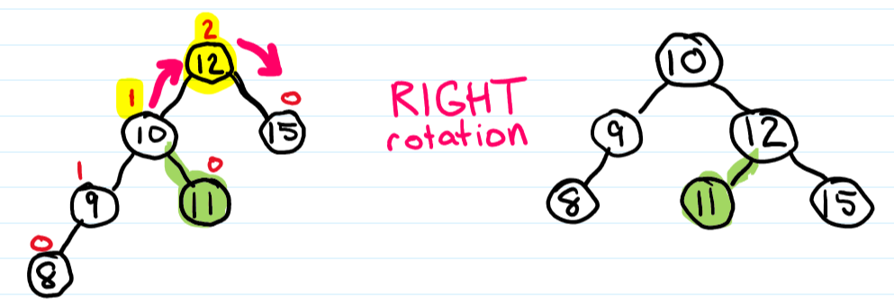
Right rotation

Slide 14
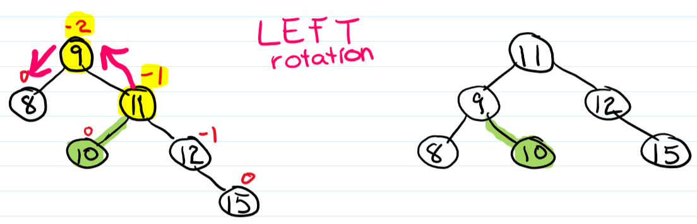
Left rotation

Slide 15
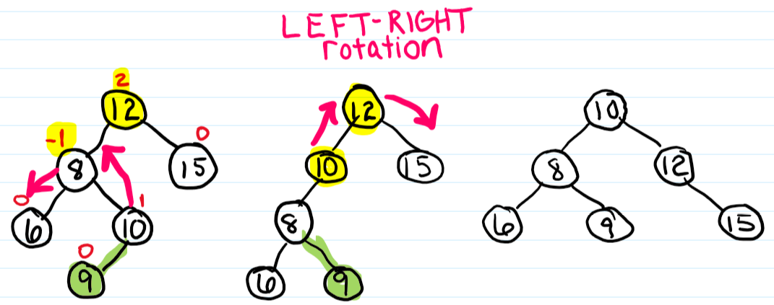
Left-Right rotation

Slide 16
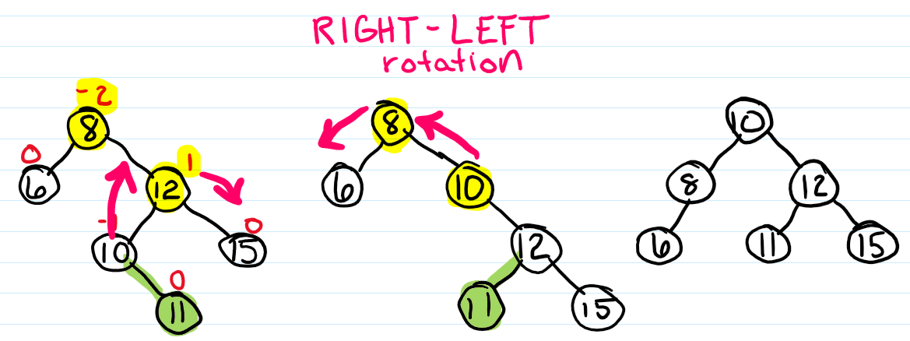
Right-left rotation

Slide 17
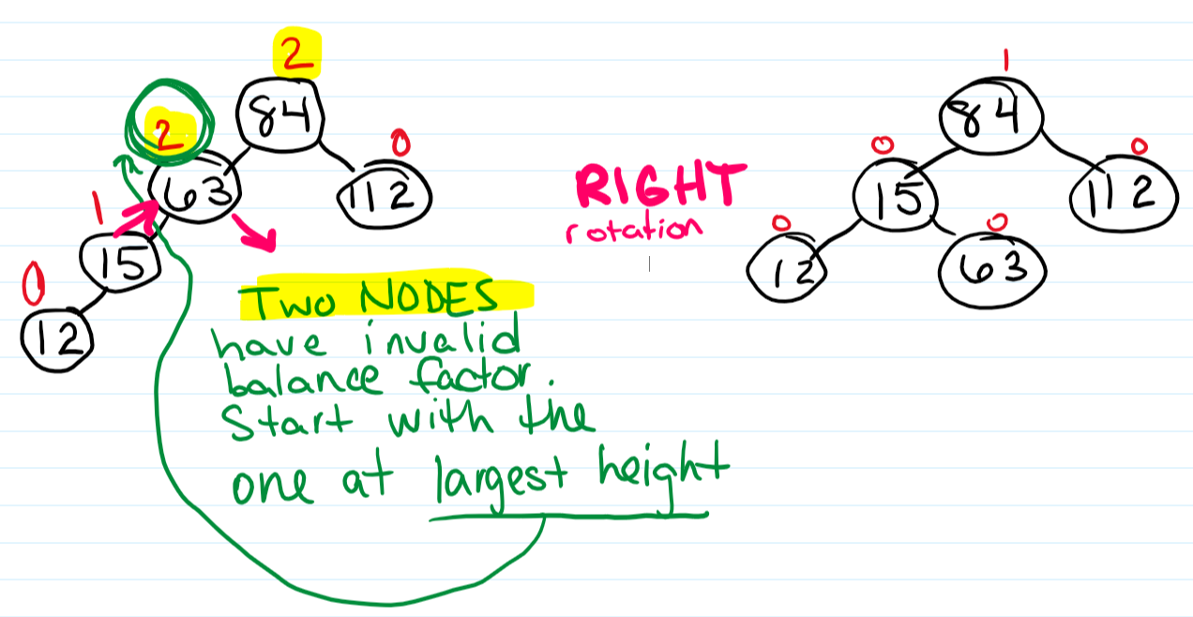
START ROTATIONS FROM DEEPEST DEPTH

Slide 18
In-class practice
Construct an AVL tree by inserting the elements successively in a list with values 5, 6, 8, 3, 2, 4, 7.
Show each step including rotations.

Slide 19
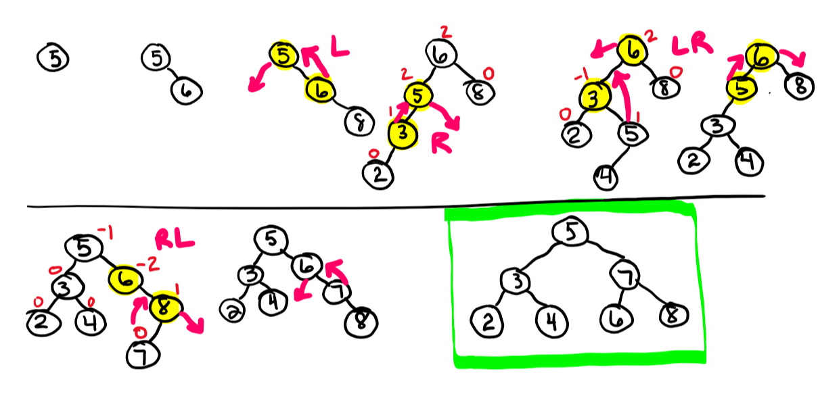
Construct an AVL tree by inserting the elements successively in a list with values 5, 6, 8, 3, 2, 4, 7. Show each step including rotations.

Slide 20
AVL TREE CODE EXAMPLE ONE
This example uses a non-recursive algorithm
for insert.
TreeNode.h
AVLTree.h (class AVL Tree)
DriverForAVLTree.cpp (main function containing AVLTree object

Slide 21
AVL TREE CODE EXAMPLE TWO
This example uses a recursive algorithm for insertions.
TreeNode.h
AVLTree.h (class AVL Tree)
DriverForAVLTree.cpp (main function containing AVLTree object

Slide 22
RED-BLACK Tree

Slide 23
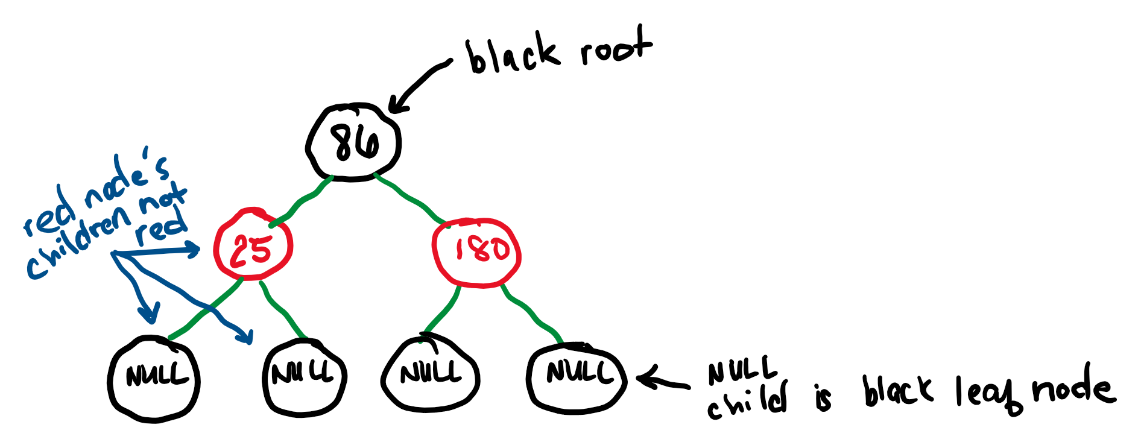
RED-BLACK TREE RULES
A red-black tree is a Binary Search Tree (BST).
Every node is colored either red or black.
The root node is black.
A red node’s children cannot be red.
A null child is considered to be a black leaf node.

Slide 24
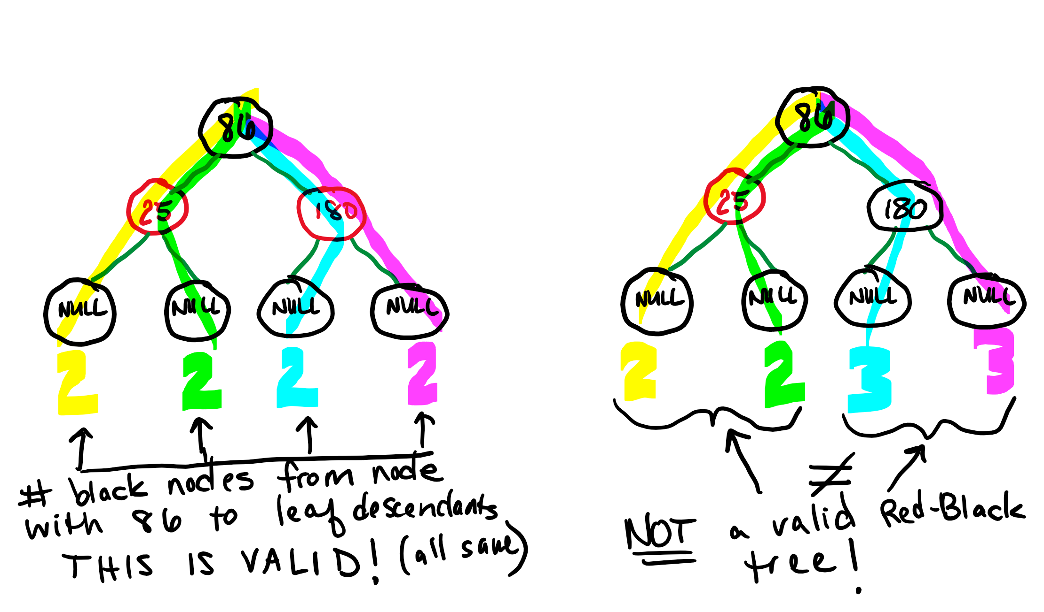
RED-BLACK TREE RULES (continued)
All paths from a node to any null leaf descendant node must have the same number of black nodes.

Slide 25
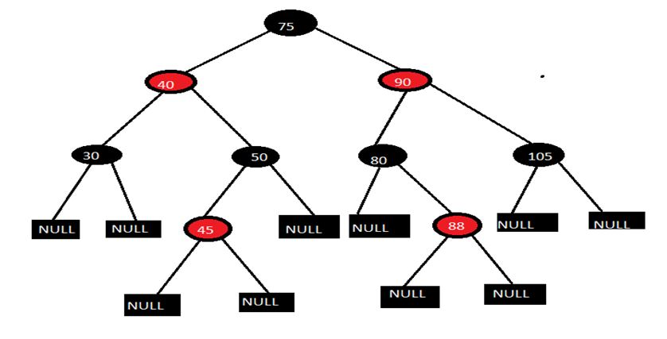
LARGER RED-BLACK TREE EXAMPLE

Slide 26
RED-BLACK TREE INSERT & DELETE
Red-black trees have such strict rules that the trickiest thing is making sure we don’t violate any of these rules when we insert or delete.

Slide 27
RED-BLACK TREE INSERTION STEPS
Create new node
Color the node red
Insert node into tree using Binary Search Tree rules. Assign parent with node's parent, uncle with node's uncle, which is a sibling of parent, and grandparent with node's grandparent.
If node is the tree's root, then color node black and return.
If parent is black, then return without any alterations.
If parent and uncle are both red, then color parent and uncle black, color grandparent red, recursively balance grandparent, then return.
If node is parent's right child and parent is grandparent's left child, then rotate left at parent, update node and parent to point to parent and grandparent, respectively, and goto step 7.
If node is parent's left child and parent is grandparent's right child, then rotate right at parent, update node and parent to point to parent and grandparent, respectively, and goto step 7.
Color parent black and grandparent red.
If node is parent's left child, then rotate right at grandparent, otherwise rotate left at grandparent.

Slide 28
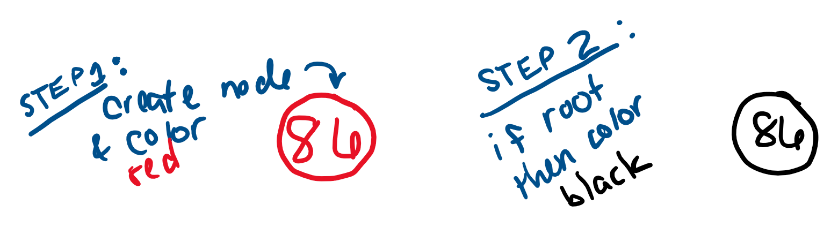
RED-BLACK TREE INSERTIONS
A newly inserted node is colored red & then a balance operation is performed on the node.
INSERT 86

Slide 29
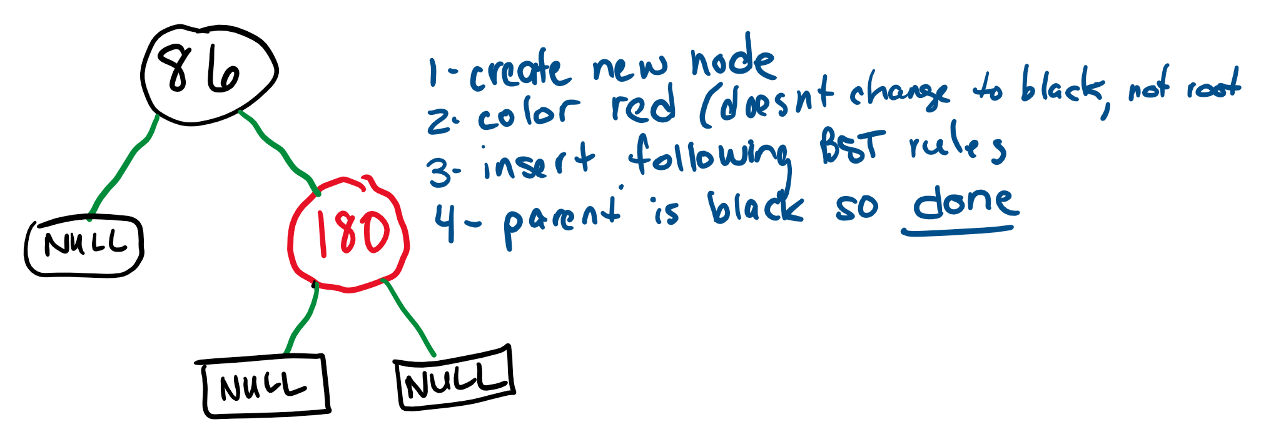
RED-BLACK TREE INSERTIONS
Insert according to BST rules.
INSERT 180

Slide 30
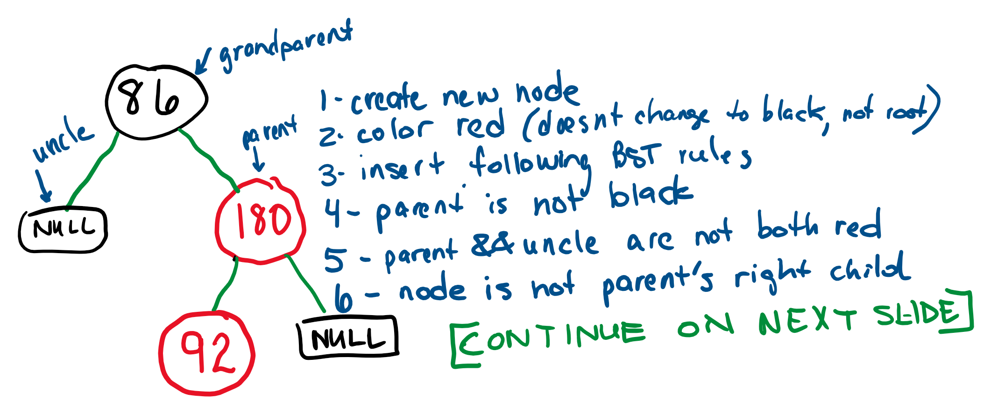
RED-BLACK TREE INSERTIONS
INSERT 92

Slide 31
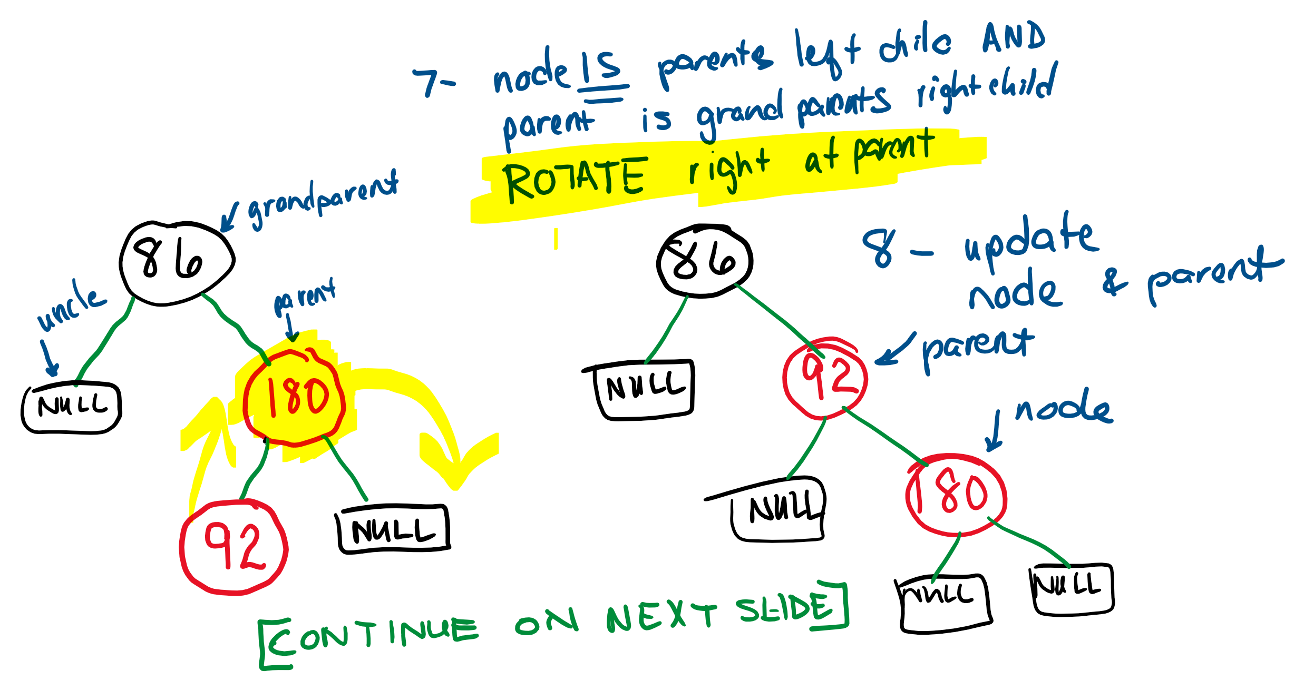
RED-BLACK TREE INSERTIONS
INSERT 92 (continued)

Slide 32
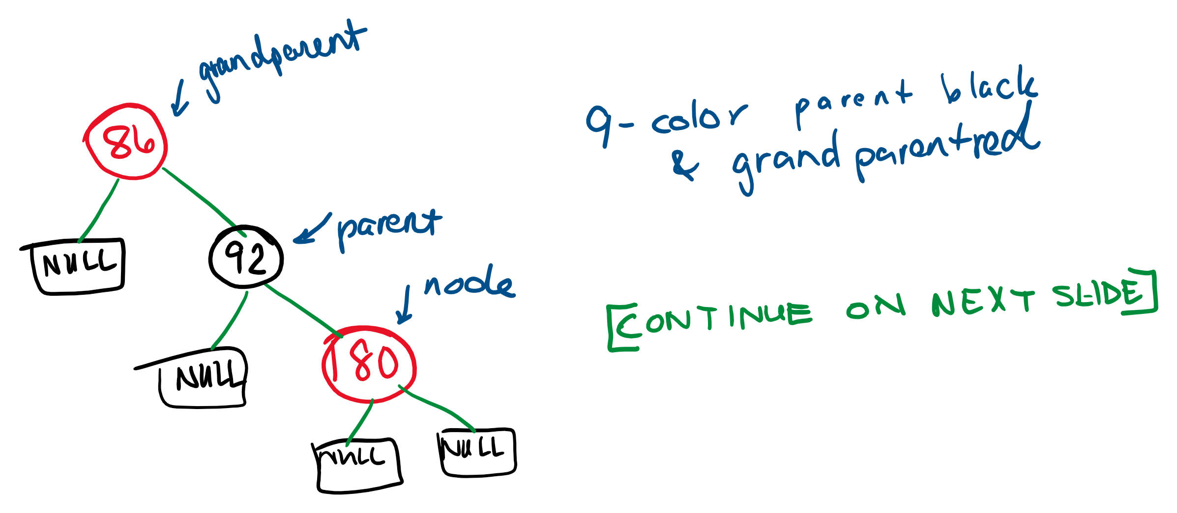
RED-BLACK TREE INSERTIONS
INSERT 92 (continued)

Slide 33
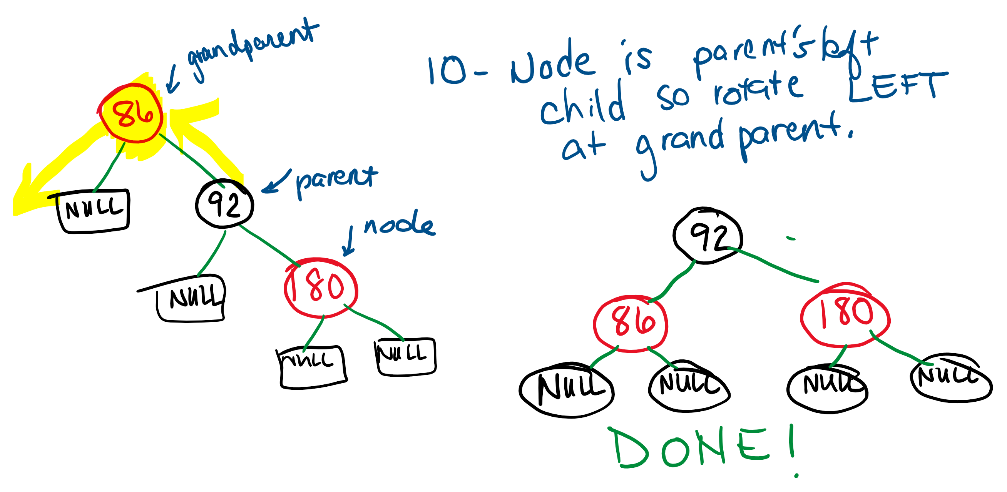
RED-BLACK TREE INSERTIONS
INSERT 92 (continued)

Slide 34
RED-BLACK TREE DELETIONS
There is an algorithm that must be followed before removal happens.
This algorithm will change colors on nodes when necessary and do rotations.
Check out Table 8.8.1 in zybooks for the prepare-for-removal case descriptions (there are 6 different cases).\

Slide 35
WHAT DO I NEED TO KNOW FOR EXAM?
You are not required to memorize insertion or deletion steps. Just be aware that there are multiple steps in either situation that require sometimes changing node colors and sometimes doing rotations in order to comply with the red-black tree rules.
You should know the rules of what makes a tree a red-black tree and also be able to look at a tree and tell if it is a valid red-black tree or not.

Slide 36
END

